Slide 1
Getting Ready for Reception

Slide 2
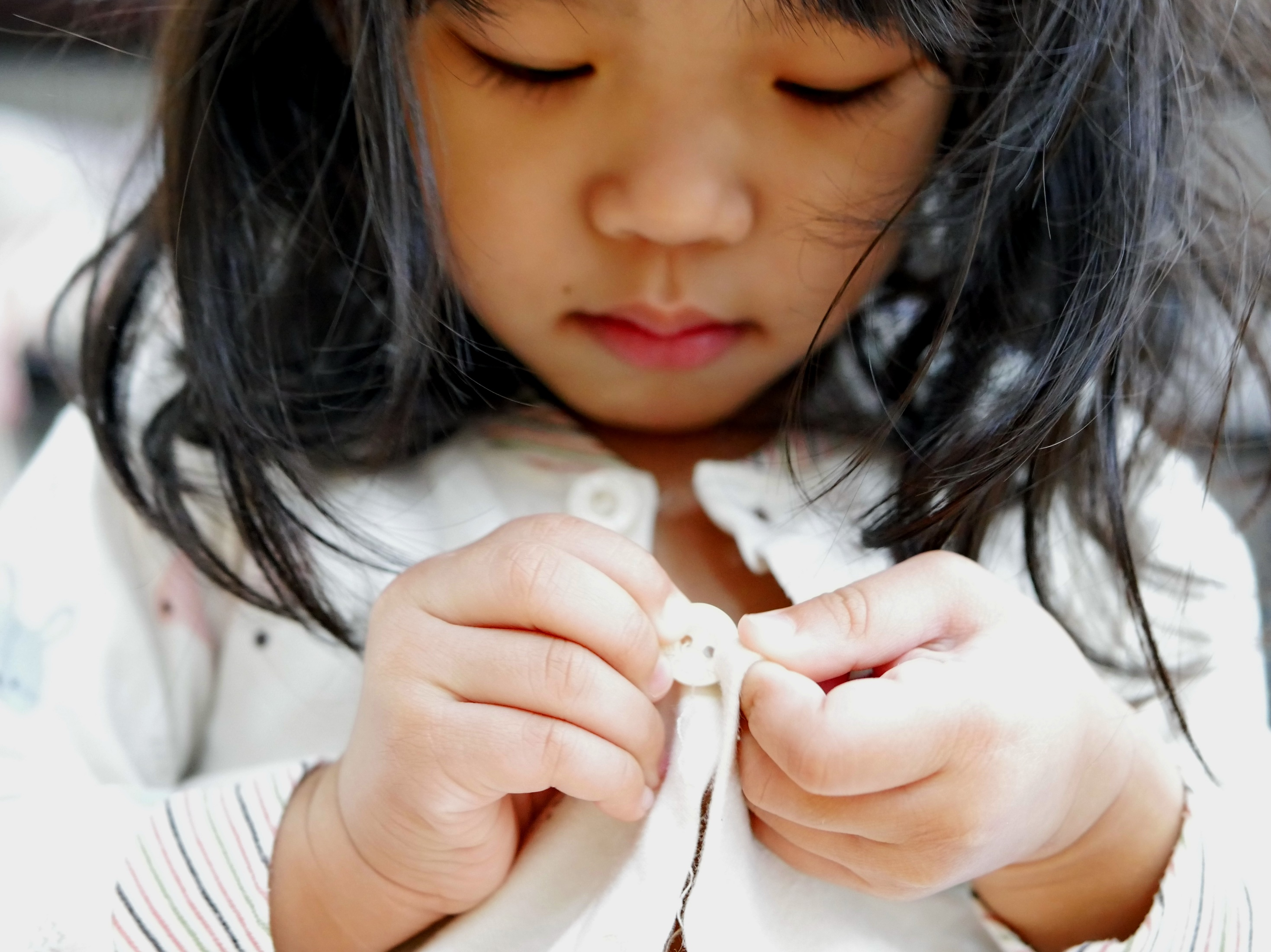
Support your child’s independence
Support your child’s independence

Slide 3
Going to the toilet
Support your child’s independence
Getting dressed
Putting on shoes
Eating
Solving simple problems
Notes:
Going to the toilet:
Resist the temptation to pop your child onto the loo and wipe their bottom. It is better to get your child into the habit of doing this for themselves.
Getting Dressed:
Avoid clothing with fiddly buckles and buttons. It is also a good idea to have a few dry runs with the PE kit.
Putting on shoes:
Shoes with laces might be a bit difficult. Go for shoes with Velcro fasteners.
Eating:
Using a knife and fork. Good table manners.
Solving simple problems:
Encourage your child to resolve problems by talking when they don’t understand or something isn’t going well. It is important that they also learn when to ask an adult for help.

Slide 4
Build up your child’s social skills

Slide 5
Organising play-dates
Build up your child’s social skills
Practising greetings
Practising conversations
Encouraging sharing & tolerance
Notes:
Organising play-dates:
Play dates with children from your child’s new class help improve their social skills and makes the leap to school less scary – they will like knowing one or two of their classmates before school begins.
Practising greetings:
Your child should know how to start a conversation with their new classmates. You can use dolls and soft toys to practise saying “hello!”
Practising conversations:
Giving your child time to talk and also time when they have to listen – teaches vital speaking and listening skills. You could take turns to talk about the best part of your day over the dinner table. Can they ask questions to find out more? Can they remember what their sibling’s favourite part of the day was?
Encouraging sharing & tolerance:
Sharing games such as Snakes and Ladders let children practise social skills and turn-taking. Be sure to use the language of turn-taking, like “whose turn is next?” and “thank you for waiting”.

Slide 6
Make a start on early literacy & numeracy skills

Slide 7
Help them recognise their name
Make a start on early literacy and numeracy skills
Share stories
Hone fine motor skills
Introduce them to numbers
Notes:
Help them recognise their name:
It’s handy if your child can find their space in the cloakroom, and can keep track of labelled clothes and other belongings.
Share stories:
Reading to your child improves their vocabulary and listening skills, and acting out stories is a great way to practise communication. Seeing you enjoy stories also primes your child to be an enthusiastic reader. You can find storytelling videos on the Oxford Owl YouTube channel and free eBooks in the Oxford Owl eBook library as an example.
Hone fine motor skills:
Developing hand strength, fine motor skills and hand-eye co-ordination all helps prepare your child for writing. Making LEGO models, using scissors and threading beads or pasta onto string are fun ways to develop hand strength. Drawing and colouring activities are good for introducing children to mark-making tools.
Introduce them to numbers:
Why not go on a number hunt around your local area and take pictures of any numbers you find? You could also share counting songs together or count objects as you set the table for dinner. Can your child get five forks or three cups out? Can they share them between family members?

Slide 8
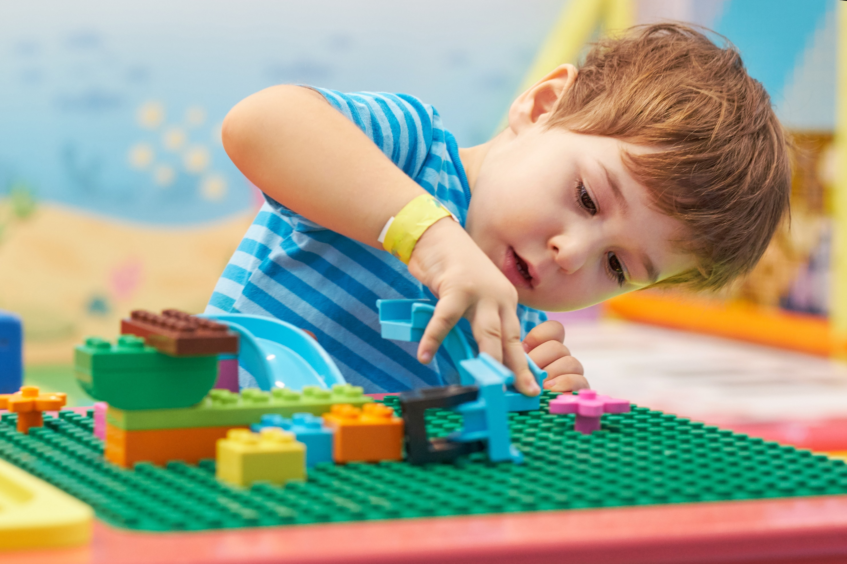
Help your child to learn to concentrate

Slide 9
Enjoy extended play together
Help your child to learn to concentrate
Follow instructions
Notes:
Enjoy extended play together:
Building kits like LEGO are great for encouraging your child’s resilience, especially if they can finish this activity in one sitting. Race-the-clock games are good for improving concentration (and are helpful when you need to be somewhere on time and need your child to get their socks and shoes on quickly).
Follow instructions:
Giving your child simple instructions to follow helps build their concentration.

Slide 10
Talk to your child about school

Slide 11
Visit the school
Talk to your child
about school
Talking about the exciting things your child is going to do at school helps
them get over any nerves.You could:
Talk about how fun school is
Practise the school routine
Notes:
Visit the school:
We will be arranging an informal picnic during the summer holidays so that the children can visit the site and you and you child can meet other families. We are holding a brief induction morning on Wednesday the 26th of August when the children will meet their new teacher and spend time in the classroom.
Talk about how fun school is:
Older siblings or friends could be enlisted to share all the things they enjoy about school – as long as they’re thoroughly briefed not to share things they’re not so keen on! Giving your child time to talk also lets them raise any concerns or questions.
Practise the school route:
It can be helpful to do a practise journey before the big day, looking for interesting things on the way. It might be a good idea to make sure your child has school-friendly bedtimes and getting-up times a few days in advance.

